Slide 1

PROJECT VIVA
SCM PROJECT 2023
Dated: 22nd March 2023
Department of Computer Science and Engineering,
Chitkara University, Punjab
Submitted By: Submitted To:
Group Name : Group 15 Mentor Name: Dr. Harveen Kaur
Roll.no : 2210990554, 2210990555,2210990553 Group: CSE-G25(Y)
Group: CSE-G25(Y)
Semester: 1

Slide 2
Project Details
Group Name | Group 15
Project Title | Hotel Manika Au Berge Management System
Team Leader | Manmeet Kaur
Details of Work division
Member | Contribution
Manmeet Kaur | Designed and coded the project on Hotel Management system
Mann Sharma | Made necessary commits to the project in GitHub
Manav Singh | Innovated the idea of total billing system within the project
2

Slide 3
Hotel
Manika
Auberge

Slide 4

PROJECT INSIGHT
This Project on Hotel Management is a general software developed (using Python) to simplify hotel operations by automating them. In this project, “Hotel Manika Auberge ” is the project’s hotel name. It covers major aspects of hotel management; it could perform the following operations- Hotel Booking, Provide you with Hotel Rooms Info, Room Service, Billing and Record-Keeping.
4

Slide 5
Project Introduction
The first one is the main module which is used to control all the other modules given in the script.
Second one is the “Customer Information” module which displays the data or the information of the customer.
Third one is the “Room Rent” module which displays the type of room is to rent by the customer .
Fourth one is the “Food Purchased” module which displays the list of food items that was ordered by the customer.
Fifth and the last one is the “Hotel Bill” module which is this module displayed the total purchased of the customer.

Slide 6
The Flow of The Project
Home Page
Customer Information
Room Booking
Restaurant module
Food Billing
Payment Record

Slide 7
The Customer Information Module
In this module, we can enter the Customer’s Details given by him/her and store it for further records.
Approach :
We entered the details using variable accessed using self keyword.
Customer module
Full Name
Address
Contact Number
Check in
Check out
7

Slide 8
Room Booking Module
This module displays a vast variety of rooms that customers want to choose along with their specific prices. In here, the customer got a vast variety of rooms along with their price from which he/she will choose their Favorite one.

Slide 9
Room Booking Module
Select 1 for Deluxe Rooms
Select 2 for executive Lounge
Select 3 for Studio Rooms
Select 4 for Business Suite
Room booking Module

Slide 10
Restaurant Module
In this module, Program will display the list of food items and their specific price in the Hotel Restaurant which are accordingly ordered by the customer . And thus would provide the bill of the items specified by the user.

Slide 11
Restaurant Module
Outputting the Total bill including tax
Inputting the choice of food n number of times

Slide 12
Total Bill module
In this module, Program will display the total purchase of the customer.
It will print a perfect bill containing Customer Details, Name of the Customer, Address off the Customer, Check-in date, Check-out date, Room no. , Room rent, Food bill, Sub Total, Additional Charges and at the last Grand Total.

Slide 13
Total Bill Module
TOTAL BILL
Room No. & Price
Food consumed Bill
Customer Details Recorded
Final Bill
Additional Taxes

Slide 14
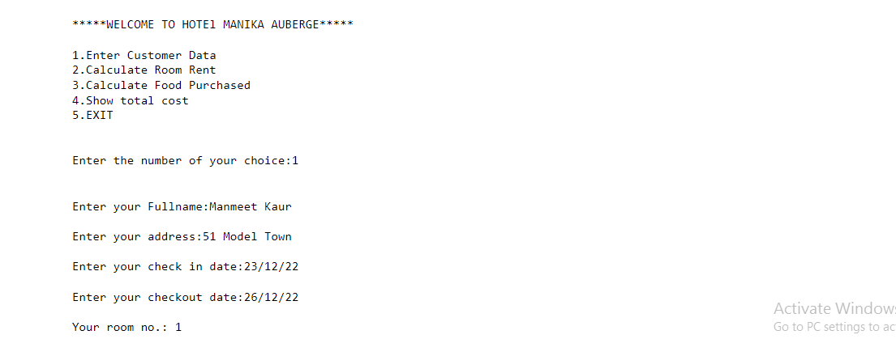
Output snapshots

Slide 15
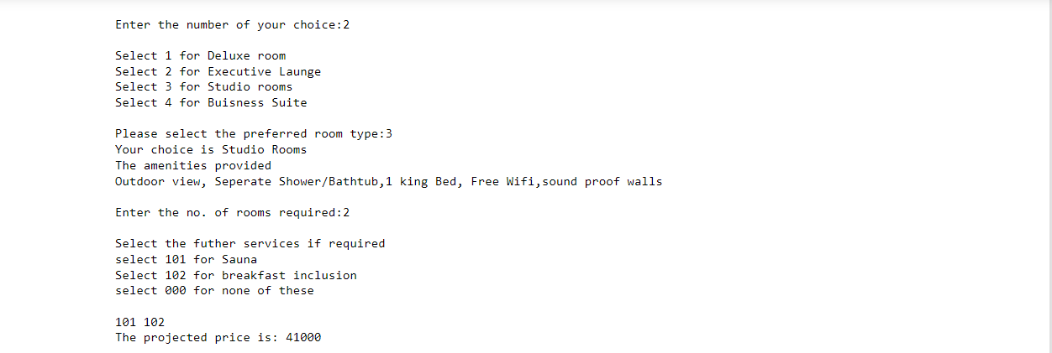

Slide 16
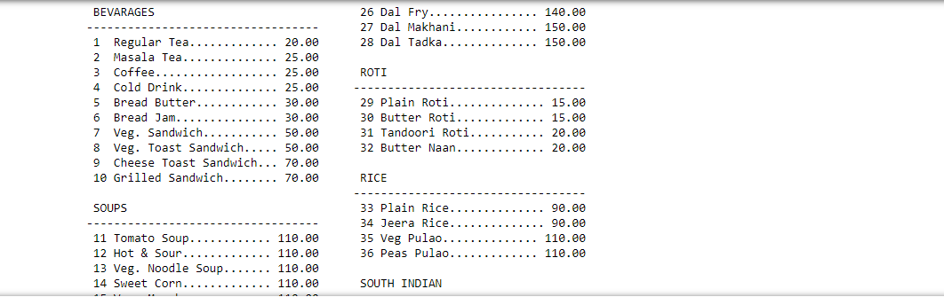

Slide 17
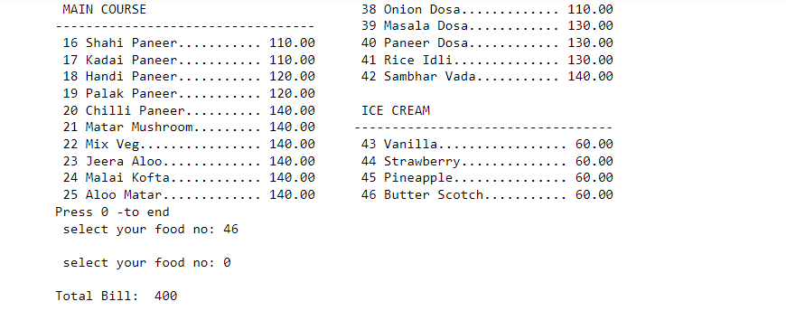

Slide 18
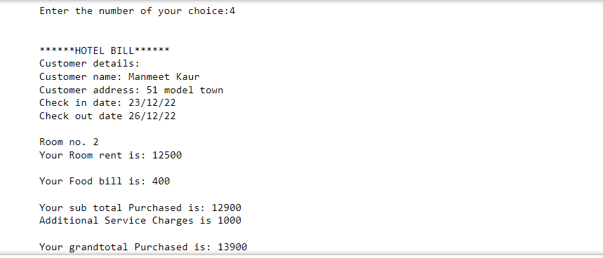

Slide 19
Future Scope & Conclusion
This project is designed to create a platform that allows booth the user and administrator to keep track of transactions like room reservations, room booking, financial administration of the hotel.
Future Scope:
This program can further create a hotel transaction database in excel and access it using various inbuilt functions. Nowadays hotel’s are providing many other facilities, this project can further be improved by adding high level Python modules for intricate details.
19

Slide 20

GitHub welcomes you!

Slide 21


Slide 22
What is Git?
Git is a popular version control system. It was created by Linus Torvalds in 2005, and has been maintained by Junio Hamano since then. It is used for:
Tracking code changes
Tracking who made changes
Coding collaboration
What does Git do ?
Manage projects with Repositories
Clone a project to work on a local copy
Control and track changes with Staging and Committing
Branch and Merge to allow for work on different parts and versions of a project
Pull the latest version of the project to a local copy
Push local updates to the main project

Slide 23
Why do we use Git?
Over 70% of developers use Git!
Developers can work together from anywhere in the world.
Developers can see the full history of the project.
Developers can revert to earlier versions of a project.
Here we use Git so that we can work on the project of Hotel management with our collaborators who can have full access to the clones and the branch of the repository.

Slide 24
What is Git Hub?
GitHub is a for-profit company that offers a cloud-based Git repository hosting service. Essentially, it makes it a lot easier for individuals and teams to use Git for version control and collaboration.
GitHub’s interface is user-friendly enough so even novice coders can take advantage of Git. Without GitHub, using Git generally requires a bit more technical savvy and use of the command line.
GitHub is so user-friendly, though, that some people even use GitHub to manage other types of projects – like writing books.
Additionally, anyone can sign up and host a public code repository for free, which makes GitHub especially popular with open-source projects.
As a company, GitHub makes money by selling hosted private code repositories, as well as other business-focused plans that make it easier for organizations to manage team members and security. We utilize Github extensively at Kinsta to manage and develop internal projects.

Slide 25
What is Repository?
A repository is a directory or storage space where your projects can live. Sometimes GitHub users shorten this to “repo.” It can be local to a folder on your computer, or it can be a storage space on GitHub or another online host. You can keep code files, text files, image files, you name it, inside a repository.

Slide 26
Problem statement for hotel management system
Web application for Hotel reservation. We will take the selection criteria from user and display the hotels list for user basing on the criteria. User can book the room if there is availability of the rooms in that particular hotel. There are three different types of user roles for the application they are administrator , hotel agent and normal user. Following are the actions provided for each user.

Slide 27
Solution
Normal user :Can register for the site Search the hotel details basing on the criteria. Book the hotel room Can modify the self details.Hotel Agent: Can register for the site Can add/update the details of the hotel. Administrator : Will approve the new hotel details added to the application Can delete the user/hotel details. Minimal Features :Adding Hotel information such as hotel name, location, number of rooms , facilities etc. to the database Listing the hotels based on different criteria selected by the user. User able to select a hotel and book a room. Booking permitted only if there are rooms available Displaying the reservation status. Registration of users. Update user details. Modify hotel details. Approval of the details entered by the hotel agent. Delete user/hotel details by admin Additional Features: Taking Feedback from user. Rating the hotels based on the feedback.

Slide 28
How to add collaborators in Git?
You can send an invitation to collaborate in your repository directly to someone on GitHub.com, or to the person's email address
GitHub limits the number of people who can be invited to a repository within a 24-hour period. If you exceed this limit, either wait 24 hours or create an organization to collaborate with more people. For more information, see "Creating a new organization from scratch."
Ask for the username of the person you're inviting as a collaborator. If they don't have a username yet, they can sign up for GitHub. For more information, see "Signing up for a new GitHub account".
On GitHub.com, navigate to the main page of the repository.
Under your repository name, click Settings. If you cannot see the "Settings" tab, select the dropdown menu, then click Settings.

Slide 29
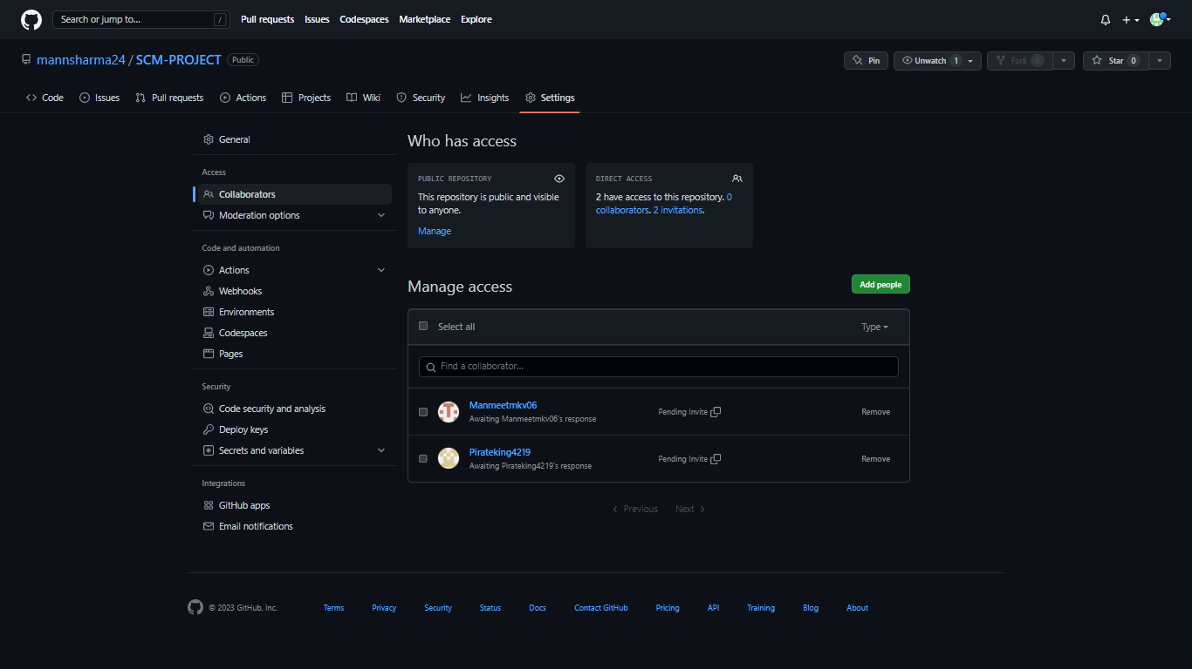
Collaborators
Collaborators:
Manmeet Kaur
Manav Singh
Owner of the repository :
Mann Sharma

Slide 30
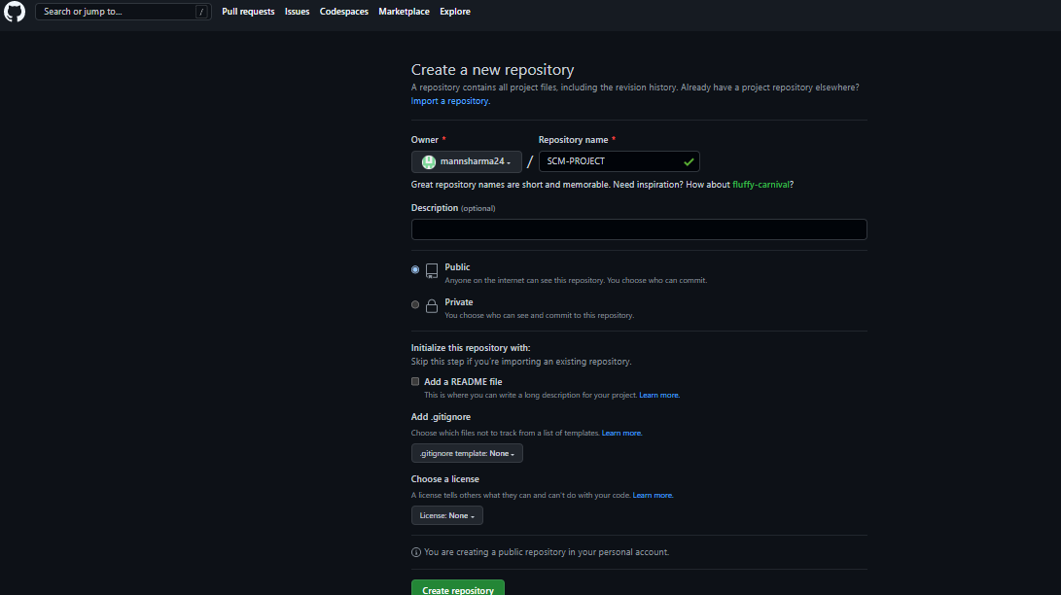
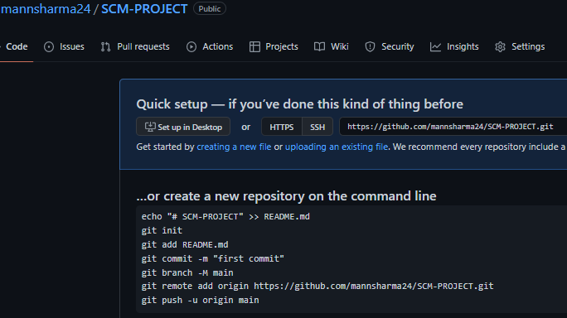
Screen-shots S

Slide 31
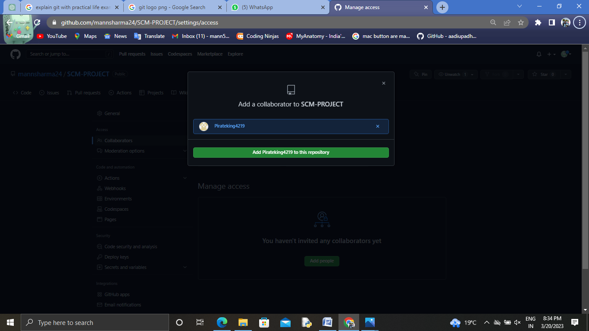

Slide 32
Adding a local repository to GitHub
In the command line, navigate to the root directory of your project.
Initialize the local directory as a Git repository.
git init -b main
Stage and commit all the files in your project.
git add . && git commit -m "initial commit"
To create a repository for your project on GitHub, use the gh repo create subcommand. When prompted, select Push an existing local repository to GitHub and enter the desired name for your repository. If you want your project to belong to an organization instead of your user account, specify the organization name and project name with organization-name/project-name.
Follow the interactive prompts. To add the remote and push the repository, confirm yes when asked to add the remote and push the commits to the current branch.
Alternatively, to skip all the prompts, supply the path to the repository with the --source flag and pass a visibility flag (--public, --private, or --internal). For example, gh repo create --source=. --public. Specify a remote with the --remote flag. To push your commits, pass the --push flag.

Slide 33
Git Commands: Working With Local Repositories
git init: The command git init is used to create an empty Git repository.
git add: Add command is used after checking the status of the files, to add those files to the staging area.
git commit: The commit command makes sure that the changes are saved to the local repository.

Slide 34
Git Push
The git push command is used to upload local repository content to a remote repository. Pushing is how you transfer commits from your local repository to a remote repo. It's the counterpart to git fetch , but whereas fetching imports commits to local branches, pushing exports commits to remote branches.

Slide 35
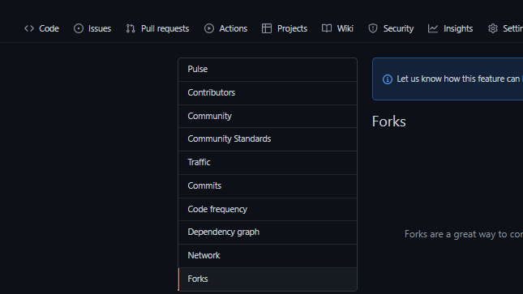
Git Fork
Forking is a git clone operation executed on a server copy of a projects repo. A Forking Workflow is often used in conjunction with a Git hosting service like Bitbucket. A high-level example of a Forking Workflow is: You want to contribute to an open source library hosted at bitbucket.org/userA/open-project.

Slide 36
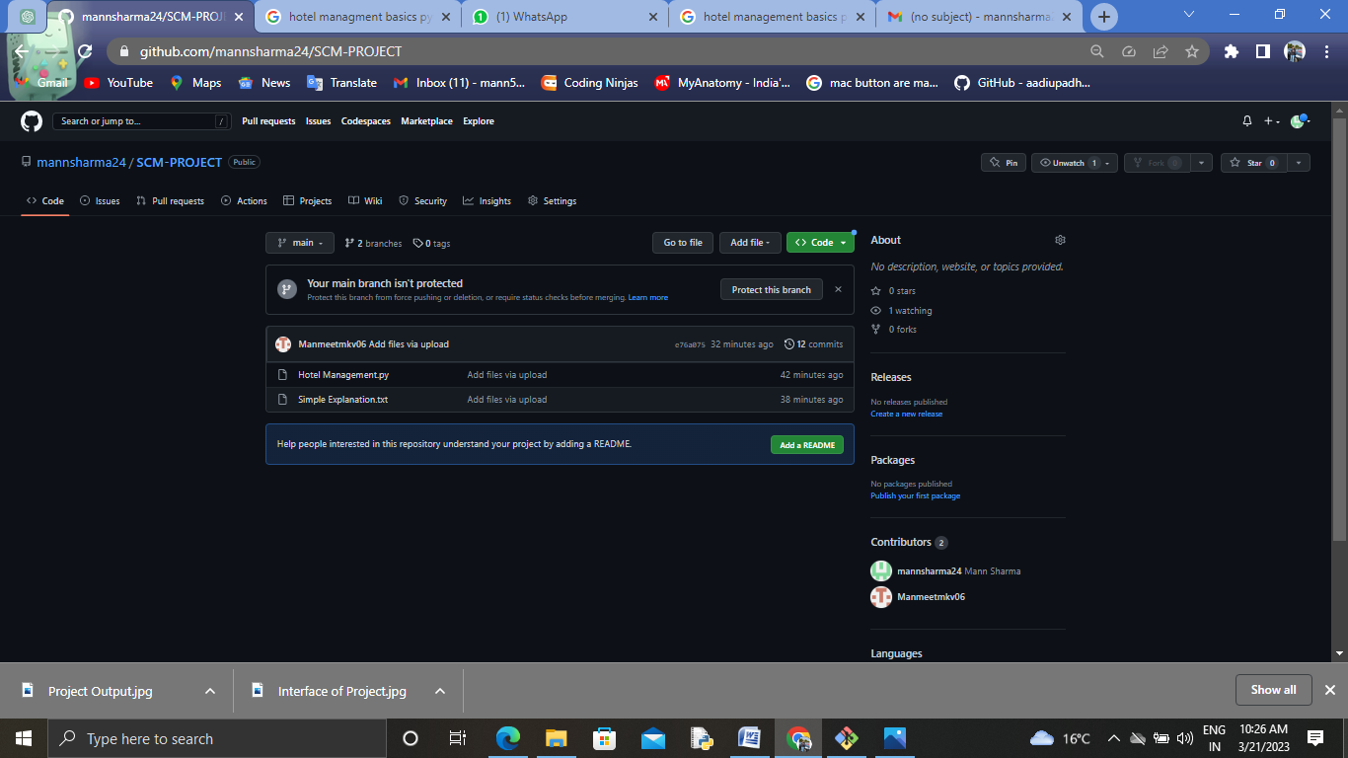
Uploading the project

Slide 37
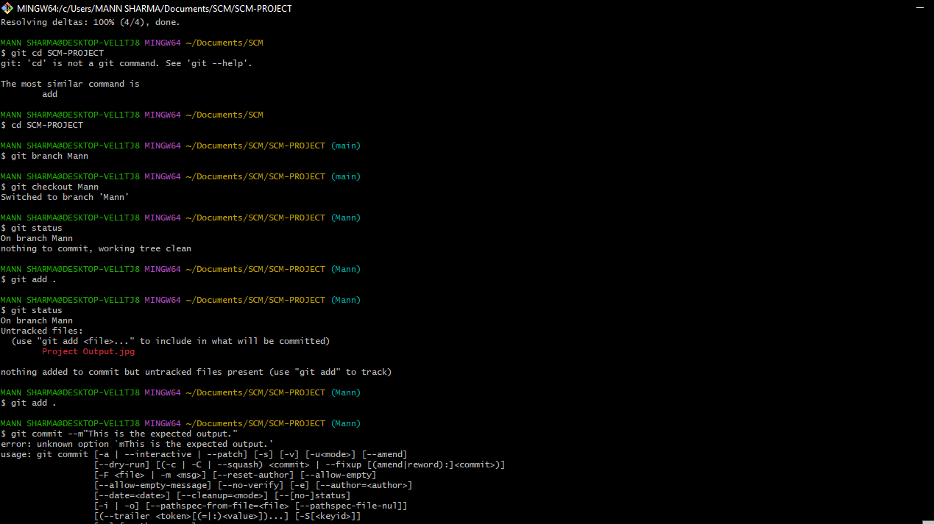
Command used to upload the project in Git

Slide 38
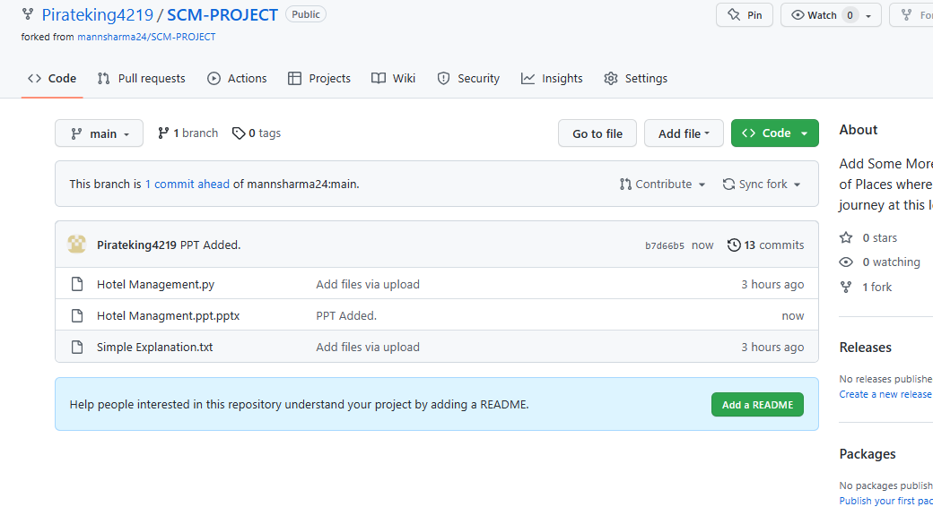
GitHub project on the collaborator’s window

Slide 39
HOTEL MANIKA AUBERGE MANAGEMENT SYSTEM
A PROJECT BY:
GROUP-15
MANMEET KAUR
2210990554
MANN SHARMA
2210990555
MANAV SINGH
2210990553

Slide 40
THANK YOU
40

